Slide 1
Etching Process Analysis through OES Spectrum Signal
BDA Eason Chiang

Slide 2
Agenda
Recap OES analysis issues on Etching Process
Use Random Forest Classifier to identify OES key wavelengths for defect defense.
Moreover, we want to take the effect of each recipe to predict the intensity of OES signal

Slide 3
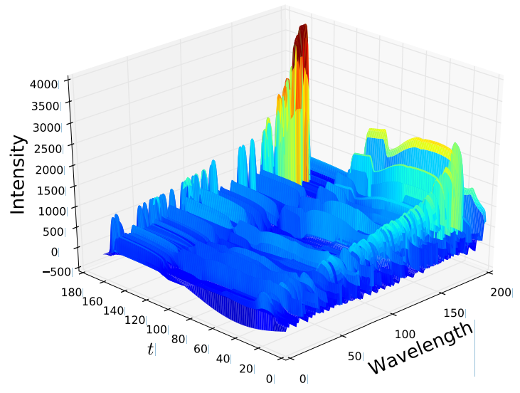
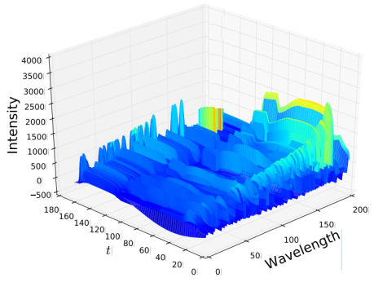
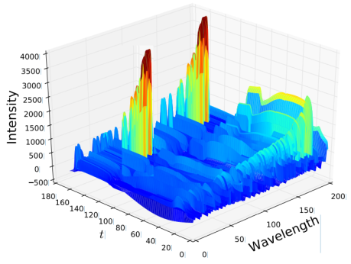
Sketch of Plasma Etching & OES signal variation
(Plasma) Etching process carves wafer surface, and produces byproducts in the chamber room.
Chemical changes in chamber room reflects in OES signal.
OES: Optical Emission Spectroscopy
Plasma Etching
Tool Chamber Room
OES Signal
Feed Gas
Etching
Recipe#A
Plasma
OES
sensor
Wafer
Wafer
Time Seq. | Recipe | Cate.
1 | #A | Etching
2 | #1 | Clean
3 | #B | Etching
4 | #2 | Clean
… | … | …
3000 | #A | Etching
Clean
Recipe#1
Wafer
…
…
…
C
…
Etching
Recipe#A
Byproduct Falling Down
C
C
C
C
C
…
C
C
C
Byproduct falling down to center of wafer.
Wafer
Time

Slide 4
Use Random Forest to identify OES key wavelength in particular recipe mix-run

Slide 5
逮到 830 的圖

Slide 6
換到其它 Mix-run 就不正確
兩張 OES 的比較圖
當多混了其它 Recipe
Mix-run 3 diff. recipes
當清潔的頻率不同
Clean more frequently

Slide 7
Take Equivalent (當量) of recipe into account
Equivalent (當量) is one estimation value for the effect of etching and clean recipe. The estimated basis is “indestructibility of matter” theory (物質不滅).
Accumulate all the equivalents of recipes by time, we found that defect happened when Carbon is greater than Silicon, and the ratio comes to about 2.2+ times.
Plasma Etching
Defect Happened
Feed Gas
Plasma
OES
sensor
Wafer
Time Seq. | Recipe | Cate. | C- Equiv. | Si-Equiv.
1 | #A | Etching | +200 | +100
2 | #1 | Clean | -100 | -50
3 | #B | Etching | +100 | +300
4 | #2 | Clean | -200 | -300
… | … | … | … | …
3000 | #A | Etching | +200 | +100
No Defect Happened
Byproduct falling down to center of wafer.

Slide 8
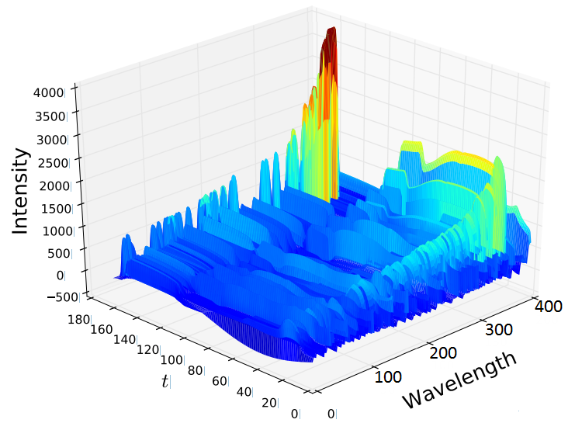


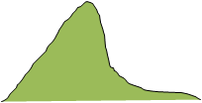
Apply Equivalent for prediction
Is it workable for F( features(當量) )= features(OES)?
It means that we can predict defect happen if we can predict OES signal jumping at some level.
Suggestions needed:
How to get feature for F( features(當量) )? ➔
How to get feature for features(OES)? ➔ TSFRESH is ok?
F( features(當量) )
features(OES)
那兩張累積圖
Area of Signal
prediction
830 的圖
Total
L2L
W2W
Area of OES Signal
F( )
…
Exponential Decay

Slide 9
時間指數遞減做法 & L2L & W2W

Slide 10
結果頁

Slide 11
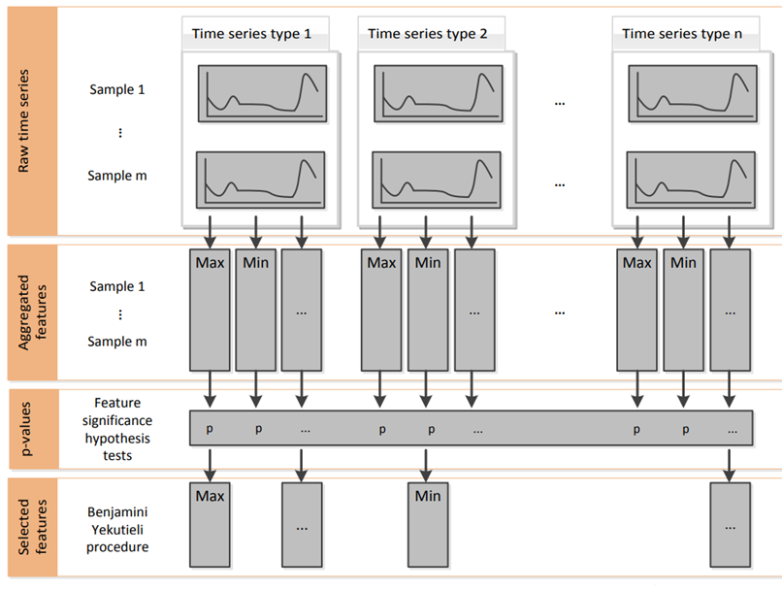
TSFRESH
Time Series FeatuRe Extraction based on Scalable Hypothesis tests
The area of time series is one kind of features.
Feature Generation
Feature Extraction

Slide 12
Feature significance test
Based on nonparametric hypothesis tests, do not make any assumptions about the distribution of the variables, which ensures robustness of the procedure.
Fisher’s Exact test: both the target and feature are binary
Kolmogorov-Smirnov test (binary feature):
Kolmogorov-Smirnov test (binary target):
Kendal rank test:
 | Target – Binary | Target – Non-Binary
Feature – Binary | Fisher’s Exact test | Kolmogorov-Smirnov test (Binary Feature/ Continuous Feature)
Feature – Non-Binary | Kolmogorov-Smirnov test (Binary Target) | Kendal rank test

Slide 13
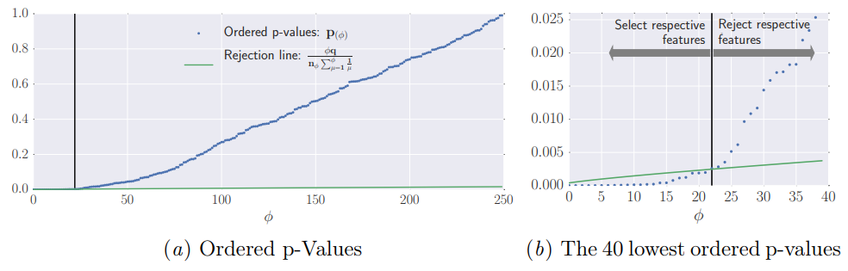

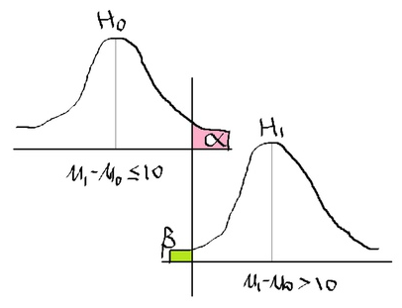
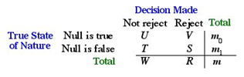
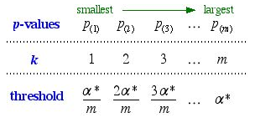

Benjamini-Yekutieli Procedure
n_{φ} is the number of all null hypotheses and
q is the FDR level the procedure controls.
It will reject all hypotheses belonging to p-values that have a lower value than the p-value at the intersection, see the left side of Fig. 2(b).
Notes:
http://www.unc.edu/courses/2007spring/biol/145/001/docs/lectures/Nov12.html

Slide 14
Backup

Slide 15
Diff. wavelength means diff. chemical element
Bromine
SF6
Chlorine

Slide 16

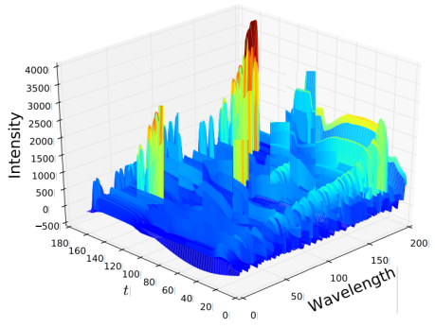
Plasma Etching
Chamber Room
OES Signal
Feed Gas
Etching
Recipe A
Plasma
OES
sensor
Wafer
Wafer

Slide 17
